Slide 1

#LifeKoKaroLift
Post-Graduate Diploma in ML/AI

Slide 2


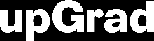
Course : Machine Learning
Lecture On : Advanced Regression
Instructor : Manish Kumar

Slide 3
Modules Included
What & Why of Overfitting and Underfitting
Regularization
Error & Optimization
Bias-Variance Tradeoff
Ridge Regression
Lasso Regression
Python Demo

Slide 4
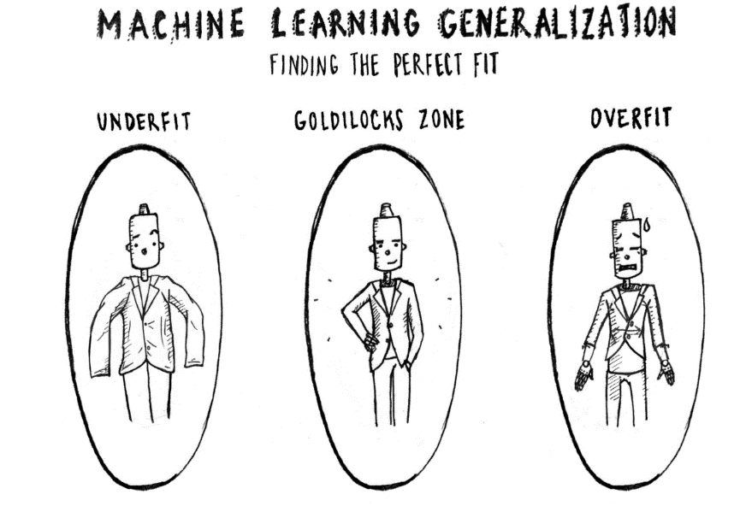
What & Why of Overfitting and Underfitting
Underfitting refers to a model that can neither model the training data nor generalize to new data.
An underfit machine learning model is not a suitable model and will be obvious as it will have poor performance on the training data.
Overfitting refers to a model that models the training data too well.
Overfitting happens when a model learns the detail and noise in the training data to the extent that it negatively impacts the performance of the model on new data. This means that the noise or random fluctuations in the training data is picked up and learned as concepts by the model. The problem is that these concepts do not apply to new data and negatively impact the models ability to generalize.

Slide 5
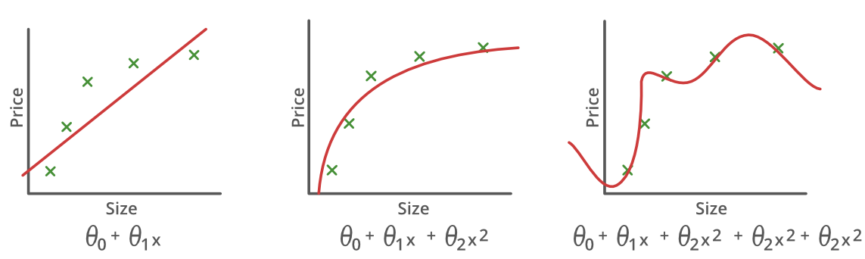
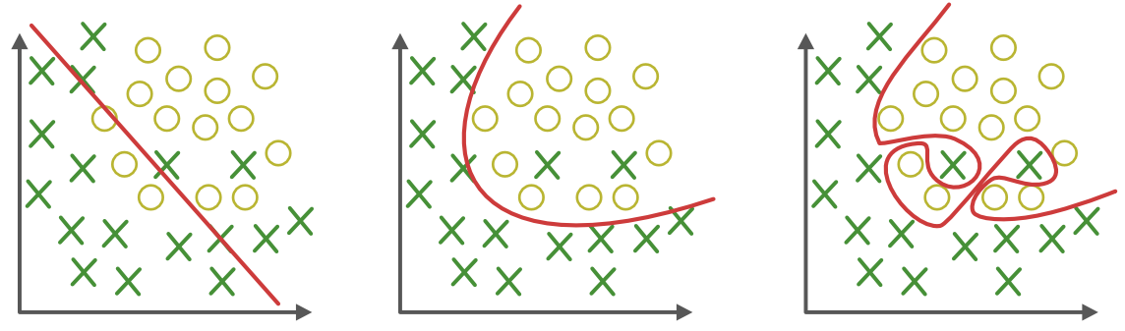
What & Why of Overfitting and Underfitting
Underfitting
Good-Fit
Overfitting

Slide 6
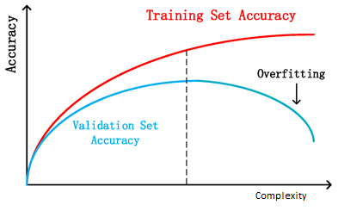
How to Detect Overfitting?
Detecting overfitting is almost impossible before you test the data. It can help address the inherent characteristic of overfitting, which is the inability to generalize data sets. The data can, therefore, be separated into different subsets to make it easy for training and testing. The data is split into three main parts, i.e., a train set ,a test set & a validate set
– Training set: A set of examples used for learning, that is to fit the parameters of the classifier.
– Validation set: A set of examples used to tune the parameters of a classifier, for example to choose the number of hidden units in a neural network.
– Test set: A set of examples used only to assess the performance of a fully-specified classifier.
By segmenting the dataset, we can examine the performance of the model on each set of data to spot overfitting when it occurs. The performance can be measured using the percentage of accuracy observed in train & validate data sets to conclude on the presence of overfitting.

Slide 7




Poll 1
How does number of observations influence overfitting? Choose the correct answer(s)
In case of fewer observations, it is easy to overfit the data.
In case of fewer observations, it is hard to overfit the data.
In case of more observations, it is easy to overfit the data.
In case of more observations, it is hard to overfit the data
A. 1 and 4
B. 2 and 3
C. 1 and 3
D. None of theses
Practice in teams of 4 students
Industry expert mentoring to learn better
Get personalised feedback for improvements
05-05-2020
11

Slide 8
Poll 1
How does number of observations influence overfitting? Choose the correct answer(s)
In case of fewer observations, it is easy to overfit the data.
In case of fewer observations, it is hard to overfit the data.
In case of more observations, it is easy to overfit the data.
In case of more observations, it is hard to overfit the data
A. 1 and 4
B. 2 and 3
C. 1 and 3
D. None of theses
Practice in teams of 4 students
Industry expert mentoring to learn better
Get personalised feedback for improvements
05-05-2020
11

Slide 9
Quiz Time
Poll Questions
How does number of observations influence overfitting? Choose the correct answer(s)
In case of fewer observations, it is easy to overfit the data.
In case of fewer observations, it is hard to overfit the data.
In case of more observations, it is easy to overfit the data.
In case of more observations, it is hard to overfit the data.
A. 1 and 4
B. 2 and 3
C. 1 and 3
D. None of theses

Slide 10
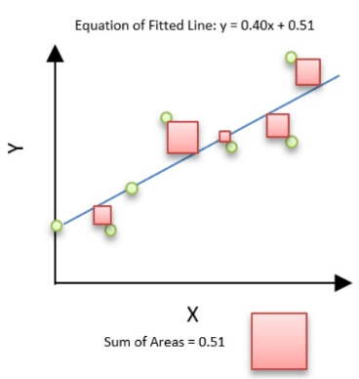
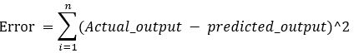
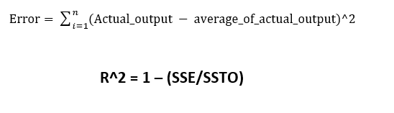
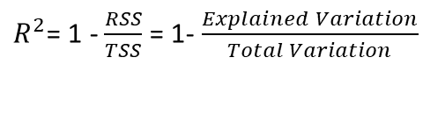
Error
Residual sum of squares (RSS)
This gives information about how much the target value varies around the regression line (predicted value).
The best-fit line is obtained by minimizing a quantity called Residual Sum of Squares (RSS) which could be optimized using Gradient Descent to get parameters of the best fit line.
Total sum of squares (TSS)
This tells how much the data point move around the mean.
R-squared is a statistical measure of how close the data are to the fitted regression line. It is also known as the coefficient of determination
$R^{2}$= 1 - $\frac{RSS}{TSS}$ = 1- $\frac{Explained Variation}{Total Variation}$

Slide 11
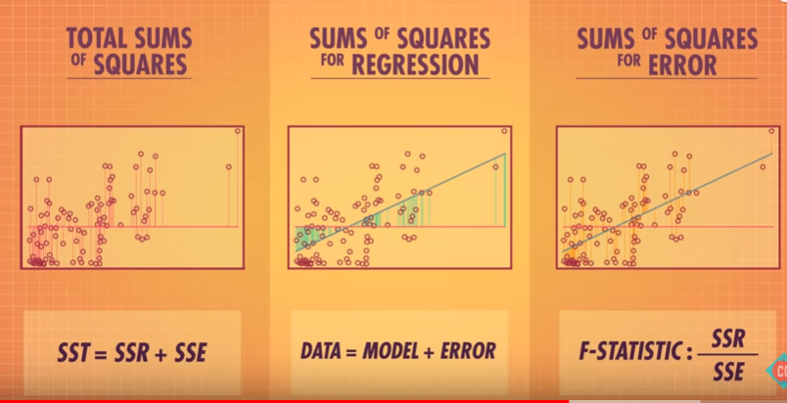
Poll 2
Which of the figures best represent RSS & TSS respectively?
(1)
(2)
(3)
Practice in teams of 4 students
Industry expert mentoring to learn better
Get personalised feedback for improvements
1 & 2
2 & 3
1 & 3
3 & 1
05-05-2020
11

Slide 12
Poll 2(Answer)
Which of the figures best represent RSS & TSS respectively?
(1)
(2)
(3)
Practice in teams of 4 students
Industry expert mentoring to learn better
Get personalised feedback for improvements
1 & 2
2 & 3
1 & 3
3 & 1
05-05-2020
12

Slide 13
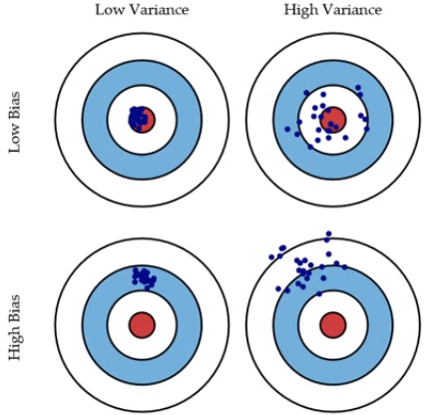
Bias and Variance in regression models
The prediction error for any machine learning algorithm can be broken down into three parts:
Bias Error
Variance Error
Irreducible Error
The irreducible error cannot be reduced regardless of what algorithm is used. It is the error introduced from the chosen framing of the problem and may be caused by factors like unknown variables that influence the mapping of the input variables to the output variable.
Low Bias: Suggests less assumptions about the form of the target function.
High-Bias: Suggests more assumptions about the form of the target function.
Low Variance: Suggests small changes to the estimate of the target function with changes to the training dataset.
High Variance: Suggests large changes to the estimate of the target function with changes to the training dataset.

Slide 14
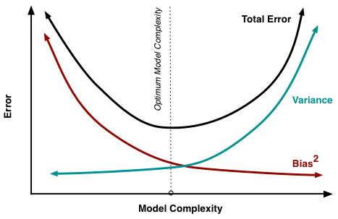
Bias-Variance Trade-Off
The goal of any supervised machine learning algorithm is to achieve low bias and low variance. In turn the algorithm should achieve good prediction performance.
Parametric or linear machine learning algorithms often have a high bias but a low variance.
Non-parametric or non-linear machine learning algorithms often have a low bias but a high variance.
The parameterization of machine learning algorithms is often a battle to balance out bias and variance.

Slide 15
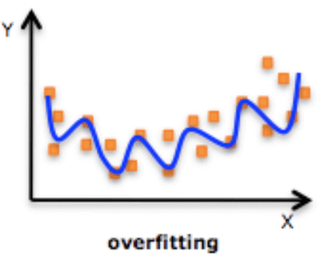
Regularized Linear Regression
One of the major aspects of training your machine learning model is avoiding overfitting. The model will have a low accuracy if it is overfitting. This happens because your model is trying too hard to capture the noise in your training dataset.
Regularization
This is a form of regression, that constrains/ regularizes or shrinks the coefficient estimates towards zero. In other words, this technique discourages learning a more complex or flexible model, so as to avoid the risk of overfitting.

Slide 16
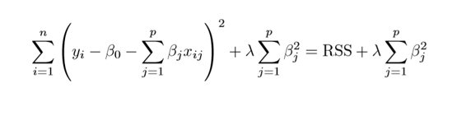
Ridge Regression
RSS is modified by adding the shrinkage quantity. Now, the coefficients are estimated by minimizing this function. Here, λ is the tuning parameter that decides how much we want to penalize the flexibility of our model. The increase in flexibility of a model is represented by increase in its coefficients, and if we want to minimize the above function, then these coefficients need to be small.

Slide 17
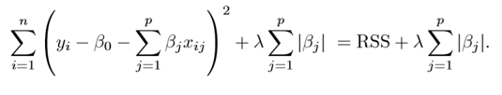
Lasso Regression
Lasso is another variation, in which the above function is minimized. Its clear that this variation differs from ridge regression only in penalizing the high coefficients.

Slide 18
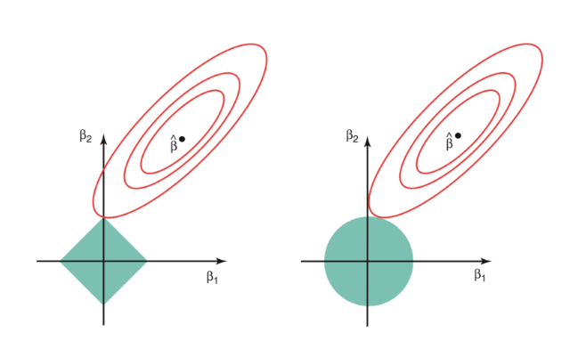
Regularized Linear Regression
The ridge regression is expressed by β1² + β2² ≤ s. This implies that ridge regression coefficients have the smallest RSS(loss function) for all points that lie within the circle given by β1² + β2² ≤ s
The lasso, the equation becomes,|β1|+|β2|≤ s. This implies that lasso coefficients have the smallest RSS(loss function) for all points that lie within the diamond given by |β1|+|β2|≤ s.

Slide 19

Let’s see an example

Slide 20
#LifeKoKaroLift
Thank You!

